Slide 1
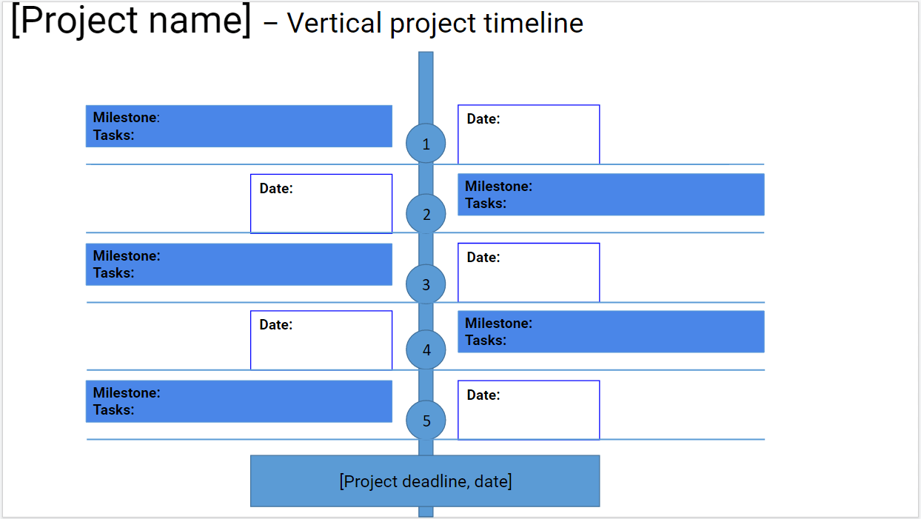
Instructions:
*READ THIS FIRST: Go to File, Make A Copy, and then fill out the template. Delete this message.
Add your project name
Add your milestones, and their dates
Add you tasks, and the time frame when you’ll tackle each (e.g. August 4th - August 10th; 9 am to 12 pm, August 10th)
Add your overall project deadline
MILESTONES:
Press SHIFT and select the entire desired milestone arrow
Drag & drop it at the desired place on the timeline
TASKS:
Press SHIFT and select the entire desired task arrow
Drag & drop it at the desired place on the timeline
PROJECT DEADLINE:
Press Shift and select the entire project deadline arrow
Drag & drop it at the desired place in the timeline
PRODUCTIVITY TIP: Track time with Clockify.me, to improve the estimations you’ll make about task durations

Slide 2
[Project name] – Vertical project timeline
Milestone:
Tasks:
Date:
1
Date:
Milestone:
Tasks:
2
Milestone:
Tasks:
Date:
3
Date:
Milestone:
Tasks:
4
Milestone:
Tasks:
Date:
5
[Project deadline, date]

